Slide 1
MBUG 2017
Session Title: How to Hit a Home Run with Banner 9
Presented By: Chris Giger, Enterprise Applications Director
Institution: Delta State University
September 12, 2017

Slide 2
Session Rules of Etiquette
Please turn off your cell phone
If you must leave the session early, please do so discreetly
Please avoid side conversation during the session

Slide 3
Agenda
Banner 9 Goals and Priorities
Banner 9 Server Setup Strategy
Banner 9 Installation and Testing
Single Sign On for Both Banner 8 and Banner 9
Go Live With Banner 9 Application
Future Banner 9 Rollout Roadmap

Slide 4
Banner 9 Goals And Priorities Goals And Priorities
Notes:
Prior Planning Prevents Poor Performance

Slide 5
Goals and Priorities
Start the movement toward Banner 9 and the momentum to keep implementing applications
Prioritize the most immediate beneficial Banner 9 applications
Priorities determined:
Web Registration
Student Attendance Tracking
Faculty Grade Entry
Applications to follow: Faculty Advising Profile, Employee Profile

Slide 6
Banner 9 Server Setup Strategy Server

Slide 7
Banner 9 Server Setup Strategy
Determine the server needs for the applications to implement
Worksheet to help determine the amount of servers/processing power needed to support the applications
Virtual Server Environment – Key to standing up and the rollout of Banner 9 servers
DBEU upgrades needed for Banner 9

Slide 8
Banner 9 Installation and Testing

Slide 9
Banner 9 Installation and Testing
Installation of priority applications
Web registration
Student attendance tracking
Faculty grade entry
Installed in both TEST and PROD environments
Installed EIS (Ellucian Identity Services) and BEIS SSO Manager to handle authentication
Tested applications internally within IT department and Registrar’s office

Slide 10
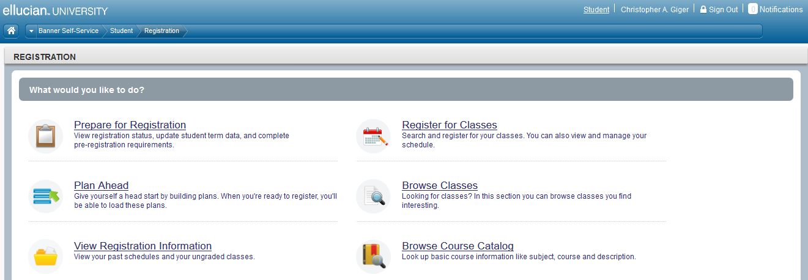
Banner 9 Installation and Testing

Slide 11
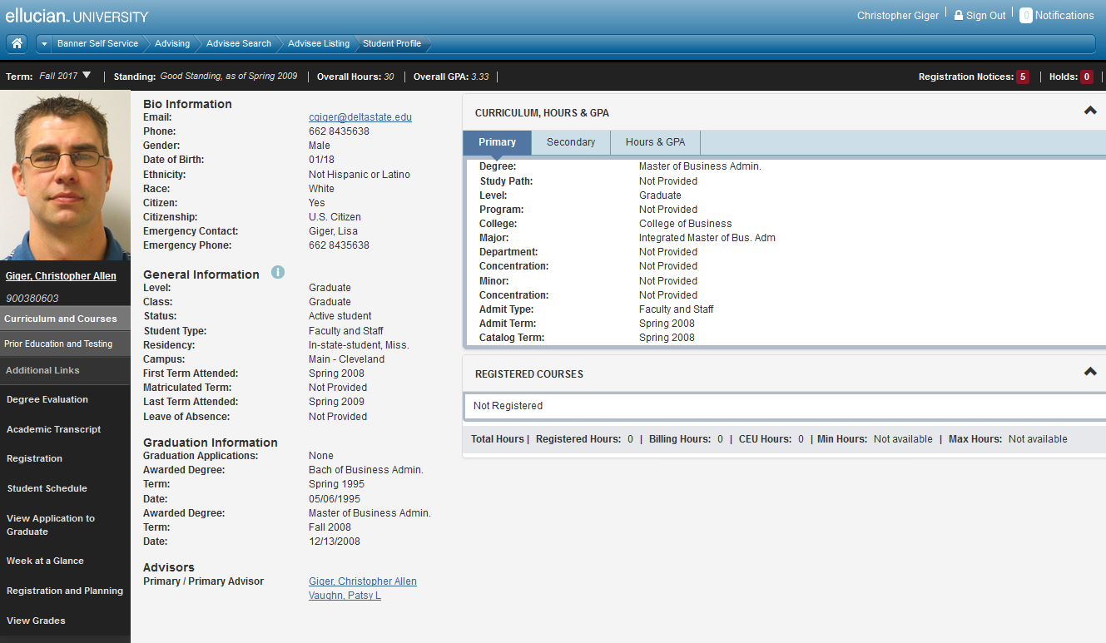
Banner 9 Installation and Testing

Slide 12
Sign On for Banner8 and Banner 9

Slide 13
Single Sign On for Banner 8 and Banner 9
Part of Banner 9 project was to move Banner 8 to single sign on
Authenticate through active directory to help with navigation between Banner 8 and Banner 9 via application navigator
Configured EIS for CAS
Configured SSO manager for Banner 8
Tested single sign on Banner 8 with DSU’s Banner power users group
Went live with SSO Banner 8 March 1, 2016

Slide 14
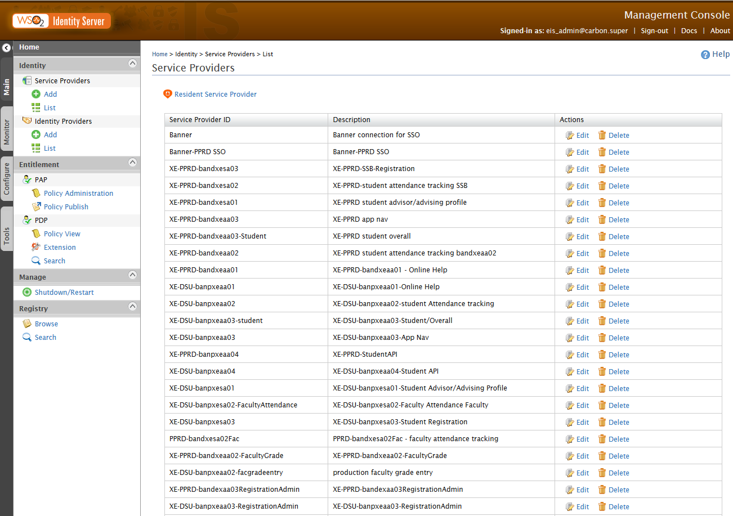
Single Sign On for Banner 8 and Banner 9
EIS

Slide 15
Go Live with Banner 9 Application

Slide 16
Go Live with Banner 9 Application
First application to go live is Web Registration
Conducted testing with Pilot group of students in our TEST environment (December 2015).
Conducted production registration with pilot group of students in (January 2016)
Conducted surveys of both groups.
“Very, very easy”
“My experience went very smooth. I like the way it functions”
“I like the way everything you need to see is on one screen”
Go live for all of campus – April 18, 2016

Slide 17
Future Banner 9 Rollout Roadmap

Slide 18
Lessons Learned
Plan for your infrastructure needed for Banner 9
Virtual servers are a must
Utilize Ellucian Customer Success site
Work with Key users to get buy in of applications
Work with Power Users group to help test
Utilize available resources – Don’t reinvent the wheel
Don’t be afraid of the
Keep the momentum going of implementing Banner 9

Slide 19
Lessons Learned
New Banner 9 Server Sizing
Servers will be reduced from 9 servers to 3 with new server sizing matrix provided by Ellucian

Slide 20
Questions & Answers

Slide 21
Thank you!
Chris Giger, Delta State University, Enterprise Application Director

