Slide 1
MBUG 2018
Session Title: The Greatest Skill Never Taught – Part 2
Presented By: John G. Igwebuike
https://www.youtube.com/watch?v=GkYmMR_IxTY&t=1309s
Institution: Alcorn State University
September 11, 2018

Slide 2
Session Rules of Etiquette
Please turn off your cell phone
If you must leave the session early, please do so discreetly
Please avoid side conversation during the session

Slide 3
The GREATEST SKILL
never taught

Slide 4
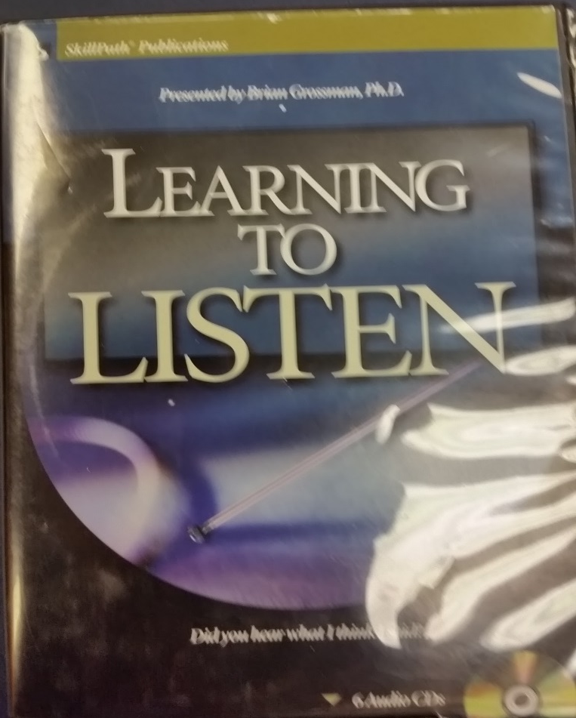

Slide 5
Drop the bags
Notes:
#1. GET YOU TO BE STILL
#2 GET YOU TO BE SILENT
#3 GET YOU TO BE CLEAR
#4 Get you to focus on what is distracting you
Get you to accept reality that life is hard for all of us – did you know that EVERY dropped something in the bag (and those of you who didn’t are still holding your bags).
When you come to practice you actually drop bags. . . But those bags are the easiest bags to drop. Many people are carry emotional bags (doubt, fear, lack of confidence). We ALL have bags – today you were real with yourself and faced up to your bag. It took an act of courage to drop the bag in front of everyone—you achieved something by the simple act of dropping the bag. You were HONEST, real, genuine. Notice how all your fellow teammates had a little bit of baggage that we all brought.
We all have bags – nothing to be ashamed of. . . I always like to do the exercise to “MODEL that I have bags” . . . Did any of you “notice” that the speaker dropped the bags, your coaches dropped the bag, teachers dropped the bag.
Show video of how Zappos does it: “employees share what is keeping them distracted.”
Take the time before practice and do a bag drop – write down the things and
Take it to the cross and leave it there:
I take these bags to the pastor and ask the pastor to “PRAY” over these bags and the person who wrote them- whatever they are going through to give them supernatural strength and courage.
If your mind is empty, it is always ready for anything; it is open to everything.
Being “present” is a simple concept, yet difficult to achieve. Being present is the act of being in the present moment in our mind and body, not thinking about the past or future, but being in the moment with the person we are listening to. We are not wishing to be somewhere else. Being present means practicing self-control. It means suppressing
One thing that hasn't been mentioned (that I personally found life changing) is understanding the paradigm shift. If you're unfamiliar with the term, it's basically your auto-pilot. It's your daily habits and responsible for every decision you make in life.
Something Bob Proctor said really hit home with me. "If your income today is much the same as it was two years ago, then it will be the same two years from now if the paradigm doesn't shift." He was right. Changing your mental programming is key if you want to be successful.
They way you experience this workshop has more to do with YOU (your perceptions, receptions, inceptions, deceptions, and conceptions) than anything else. It will color and shape the information today.
https://www.youtube.com/watch?v=-zdJ1ubvoXs ←Excellent video 9 minutes (a similar dropping the bag exercise).
Reasons:
There is an “honoring” of presence
Quiet the mind – still the mind
Listening to the messages that are being given to you?
Zen – opportunity to listen to yourself.
Ready oneself to hear the messages of others?
enable you to hear the message your Inner Child, Your Inner Intelligence, is trying desperately to share.
Hear the voice of GOD,
Enable you to quiet the mind
Feed your soul, heal the body and gain inner peace.
Introverts gain strength from silence
So we can bring forth the best US (“shi”)
The purest form of listening is to listen with out memory or agenda
Story of Zen Master - poured the cup over – to empty our bags so more can come in.
Zen listening
focus on self-awareness, intersectionality, and intercultural understanding,
it’s important to acknowledge at the meeting that we are all connected with issues that may go throughout minds. We are simply recognizing it as such. you are open to talking about areas for improvement. Doing this shows your manager that you have a realistic view of your own performance
Watch the content of the conversation – look for and examine WHAT (look at the conditions) and WHY (the emotions, feelings)
Puts you in a happy state.
Allows you to LISTEN to you. This is what ZEN listening is about… Listening to oneself, breath, heartbeat, thoughts.
Tell one unique thing about you that no one knows.
Notice Mr. Rogers- emptying himself, taking off his shoes, putting on new shoes, dropping his sport coat so he could put on another,
Jesus’ first miracle started symbolically after an “emptying”—the emptying of all the wine.
How do I show up in a way that is absolutely honest, absolutely respectful, absolutely
Your presence has a value and a contribution to other people.
When we LET GO we can expose ourselves to the possibility that we can GRAB HOLD of something better (opportunity to listen to ourselves—better; moment to focus on that thing getting us—better; time to focus on the matter for a few minutes—better; opportunity to acknowledge what is common for all of us---better; ).
We let go of our judgments, let go of our prejudices, let go of our assumptions, let go of our predispositions so that we can fill up with something more.
Student-Athlete:
From a student-athlete we are actually told to drop our bags, we put our bags down so that we can focus and be ready to practice to so we can listen to ourselves, listen to our teammates, listen to the coach, listen to the referee, listen to the environment
The actual process of dropping our problems in the bag is symbolic for dropping our problems into a bag [we drop our problem in a bag]
This is an exercise to help us LISTEN TO YOU – if you don’t really listen to you how can you listen to your coach? How can you listen to your team mates? How can you listen to the bounce of the ball;? How can you listen to the events of the game? How can you tune in to you and your A game and tune out the world. How can you listen to your heart beat, your breathing, your goal, the sounds of you in you’re a-game. Don’t worry about the game, just worry about the process. The process of dropping the bags? If you focus on the process of just clearing your mind, letting go you can be more focused, you can bring your very best self, you can and if everyone brings their best self and you bring your best self and the team brings their best self, you can be more powerful, you get an edge, you get the listener’s edge,
This is an exercise to build a community of people with clear minds; This is an exercise to change the environment; To change the culture of the people you have around (people who are clear, people who’ve focused on their breathing, who are more relaxed, who are more focused. You want to work with people who ar efocused, in their element, who bring their A-game, less apt to go off, more stable, more relaxed.
It is aimed to get RESULTS: clearer mind.
GET YOU TO LISTEN TO OTHERS – Note first we get you to listen to you.

Slide 6
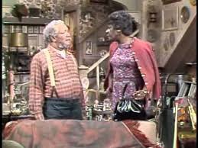
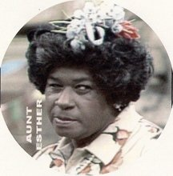
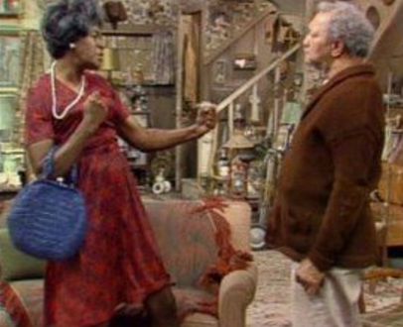
Notes:
Fiesty Aunt Esther: Go on I’m all ears . . .
Fred: “No your not, your all mouth.” https://www.youtube.com/watch?v=TX0v8qgaxJo ←funny
https://www.youtube.com/watch?v=TX0v8qgaxJo
Aunt Esther never dropped her bags

Slide 8
Notes:
The sound made when glass hits glass . . . To listen.
STORY: I’m not like this anymore.
This super-duper complicated and unpronounceable word. And when I finally found the definition at Ohio State University’s language center, this what they told me the word (radicals). The hards word in the world: “TING”

Slide 9
TING begins with
Notes:
To listen. ting
tiNG/noun
a sharp, clear ringing sound, such as when a glass is struck by a metal object. Verb
1. emit a sharp, clear, ringing sound.
The sound made in the final syllable of the word ListenING ListenING ListenING as in TING

Slide 11
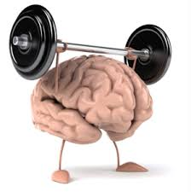
EXERCISE
Drop the bags

Slide 12
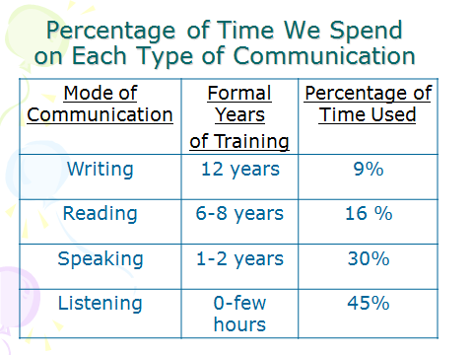
The true lack of communication skill training.
Notes:
Employers lament the lack of communication readiness of (new) hires. Yet, the true lack of communication readiness based on the chart is with listening.

Slide 13
%
Time Used
@Work
45%
30%
1-3
16%
6-8
9%
12
Notes:
1 2 3 4 = first we learn to listen (after all there is an “e-a-r” in the word learn . . . So, first we begin to listen, then speak, then read, then write and they all are possible because we were able to listen.
If we want to improve student learning outcomes perhaps first we should start with listening.
If we want to improve student writing outcomes perhaps first we should start with listening.
If we want to improve student reading outcomes perhaps first we should start with listening.
If we want to improve student speaking outcomes perhaps first we should start with listening.
If we want to improve student retention perhaps we should start first with LISTENING.

Slide 14
%
Time Used
@Work
45%
30%
1-3
16%
6-8
9%
12
Notes:
1 2 3 4 = first we learn to listen (after all there is an “e-a-r” in the word learn . . . So, first we begin to listen, then speak, then read, then write and they all are possible because we were able to listen.
If we want to improve student learning outcomes perhaps first we should start with listening.
If we want to improve student writing outcomes perhaps first we should start with listening.
If we want to improve student reading outcomes perhaps first we should start with listening.
If we want to improve student speaking outcomes perhaps first we should start with listening.
If we want to improve student retention perhaps we should start first with LISTENING.

Slide 15
# Years Training
1-2
6-8
1-3
0 - few hrs
6-8
12
12
Notes:
1 2 3 4 = first we learn to listen (after all there is an “e-a-r” in the word learn . . . So, first we begin to listen, then speak, then read, then write and they all are possible because we were able to listen.
If we want to improve student learning outcomes perhaps first we should start with listening.
If we want to improve student writing outcomes perhaps first we should start with listening.
If we want to improve student reading outcomes perhaps first we should start with listening.
If we want to improve student speaking outcomes perhaps first we should start with listening.
If we want to improve student retention perhaps we should start first with LISTENING.

Slide 16
PARADOX
Notes:
To improve your speaking, improve your listening,
To improve your writing, improve your reading,

Slide 17
Don’t miss out.

Slide 18
MISS
MYTHS
MISSTEPS
MISTAKES
MISNOMERS
MISJUDGMENTS
MISTREATMENTS
MISUTILIZATIONS
MISAPPLICATIONS
MISTRANSLATIONS
MISCALCULATIONS
MISAPPREHENSIONS
MISCONSTRUCTIONS
MISINTERPRETATIONS
MISUNDERSTANDINGS
MISCONCEPTULIZATIONS
Notes:
Propogate
Perpetuate
Problem

Slide 19
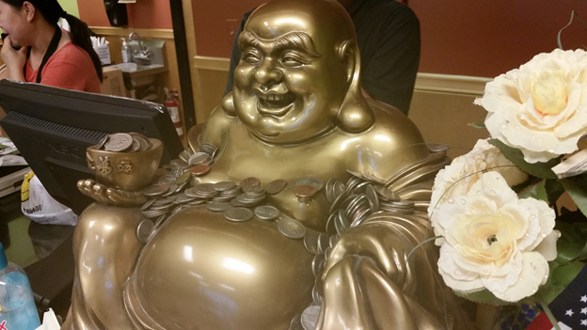
Notes:
Ear lobe as a sign of longevity. I went to a Chinese restaurant and the cashier caught me staring at the Buddha statue. She asked what are you staring at . . . The Ears. The Ears. Those ear lobes…The long flowing earlobes. “ I said. I shared with her, they signify “wisdom as I understand it”. She fine-tuned my understanding bby sharing that the ears mean “FULLNESS” as in a “full” life. I added to it as in full attention, listening fully, or “the earth is the Lords and the “FULLNESS” thereof.
Listen fully
Get the full store
Don’t be full of yourself

Slide 20
Notes:
deasil - clockwise; in the direction of the sun

Slide 21
Notes:
deasil - clockwise; in the direction of the sun

Slide 22
shi = you
Notes:
You must know yourself so that you can get yourself out of the way. You don’t want to insert yourself in someone’s problem. It’s how you get there. You must know the person you are talking to and talking with. We know you are smart. I’m just trying to change your world to help it be a little bit easier. I am trying to give you more tools to make your purpose a little bit more easier so that you can get the right information. Get what you needs. I am not trying to change your world, just trying to give you more tips and tools. Get into the why?
The mediator has to control the process (the temperature – sets the tone). Take the time to figure out what you have in front of you before you can
To listen. To be PRESENT. To be “fully” present. To fully present yourself. You are not fully presenting yourself when you have baggage.
It’s about “how” we communicate.
What are your HOTBUTTONS (e.g., rudeness to children - )
What are your non-verbal communications

Slide 23
shi
Base
Notes:
Ideas have the potential to change your life. Listening affords us the opportunity to take in ideas.
To listen. To be PRESENT. To be “fully” present. To fully present yourself. You are not fully presenting yourself when you have baggage.
The base 10 you. As in base ten as in infinite as in unlimited and unstoppable.
AbsTENtion from speaking
Your “hot buttons”
Boost your reTENtion of the information
AtTENding the speaker
AtTENtion
LisTEN
enlighTEN yourself
inTENtionality when you listen.
FrighTEN
heighTEN
hearTEN the speaker if we hasTEN to listen.
ConsisTENT
GlisTEN
The “empty” you - impossible to really listen to another person without emptying yourself. M. Scott Peck

Slide 24
Notes:
deasil - clockwise; in the direction of the sun

Slide 25
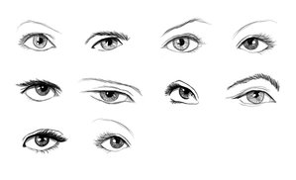
MU
Notes:
The eyes that see also send. The eyes that receive also respond. Therefore, send positive message nd respond effectively with your eyes. Give your undivided attention to the speaker. The Chinese symbol that we used to describe listening used the eyes and undivided attention. Absolutely important is dedicating your undivided attention to the speaker if you are to succeed as an active listener. Eye contact is less important. In most listening situations people use eye contact to affirm listening. The speaker maintains eye contact to be sure the listener or listeners are paying attention. From their body language the speaker can tell if he is speaking too softly or loudly, too quickly or slowly, or if the vocabulary or the language is inappropriate. Listeners can also send messages to speakers using body language. Applause is the reason many performers perform. Positive feedback is an endorphin releaser for the giver and the sender. Eye contact can be a form of positive feedback. BUT, eye contact can also be a form of aggression, of trying to show dominance, of forcing submissive behavior. All primates use eye contact to varying degrees. We should be careful how we use it when listening. If we want to provide undivided attention to a child, a better way to show your attention is to do a "walk and talk" as we discussed in Chapter 2. Walk and talk is such a successful strategy that works well for active listening!

Slide 26
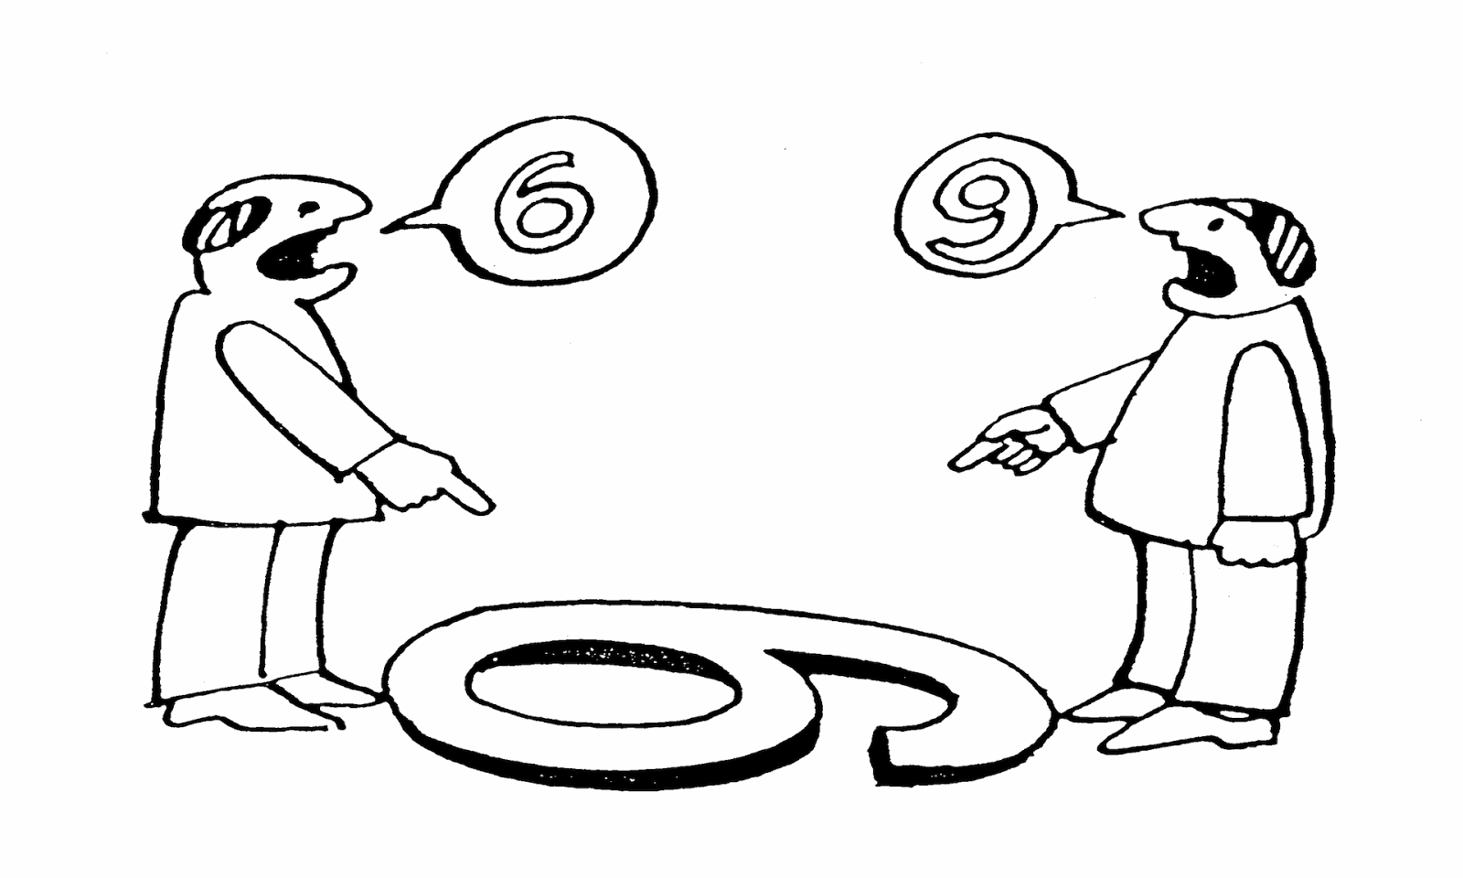
See other perspectives
Notes:
Which respective perspective do you expect to respect?

Slide 27
EXERCISE
Drop the bags

Slide 28
Transform nine with one line.
SIX6
Notes:
Lead in to the fact that LISTEN has six letters and so does the Chinese radical for listening (TING)

Slide 29
Notes:
Ten-Eyed Listening - speaks to the wholeheartedness of listening. Not only should we listen like kings, but even Kings and Queens need to listen with open wholehearts and open hearts (Keep in mind the visual of a “heart” and how it is open – speaks to transparency). Think of exercise where you pass out the bendable straw-like pieces and each person makes what he or she will out of it. I picked a heart . . .Ten-eyed listening? What does it mean? It recognizes there are other ways in which we can see – what other ways can we see – with our silence, with our eyes, with our nose, with our thoughts, minds, heart, love, . Notice how it looks a t
http://franderam.files.wordpress.com/2012/02/reflective-essay-asian-studies-distinction.pdf

Slide 30
Notes:
Ten-Eyed Listening - speaks to the wholeheartedness of listening. Not only should we listen like kings, but even Kings and Queens need to listen with open wholehearts and open hearts (Keep in mind the visual of a “heart” and how it is open – speaks to transparency). Think of exercise where you pass out the bendable straw-like pieces and each person makes what he or she will out of it. I picked a heart . . .Ten-eyed listening? What does it mean? It recognizes there are other ways in which we can see – what other ways can we see – with our silence, with our eyes, with our nose, with our thoughts, minds, heart, love, . Notice how it looks a t
http://franderam.files.wordpress.com/2012/02/reflective-essay-asian-studies-distinction.pdf

Slide 31
Notes:
Ten-Eyed Listening - speaks to the wholeheartedness of listening. Not only should we listen like kings, but even Kings and Queens need to listen with open wholehearts and open hearts (Keep in mind the visual of a “heart” and how it is open – speaks to transparency). Think of exercise where you pass out the bendable straw-like pieces and each person makes what he or she will out of it. I picked a heart . . .Ten-eyed listening? What does it mean? It recognizes there are other ways in which we can see – what other ways can we see – with our silence, with our eyes, with our nose, with our thoughts, minds, heart, love, . Notice how it looks a t
http://franderam.files.wordpress.com/2012/02/reflective-essay-asian-studies-distinction.pdf

Slide 32
FHLUR MODEL TRANSFORMATIVE LISTENING
Transforming
others
Focus
Hear
Listen
Understand
Respond
self
→
→
→
→
→
Slowing - Suspending - Surrendering - Stopping
Sentipasente (sensing/thinking)
Standing
Staying
© 2018 John G. Igwebuike, The Lead Listening Institute. All rights reserved.
Notes:
Sentipensante (Sensing/Thinking)
Slowing – suspending = surrender (your expectation) – stopping -→ entering into their world (blue). Jesus said go into all the world and preach the gospel (all the world: different worlds, new worlds, different worlds, it’s a different world from where you come from, worlds you are not used to; worlds you never been before, people’s inner worlds,
Others over self. I am them and they are me. What we are doing is going beyond knowledge, it is really engaging the student. Education assigned to bring out the best in a broad way. Leadership – construct amulets that typify how they see themselves as a leader. Who inspires you to become a better; why are you doing this? What impact do you want to have. 20 years from now they are going to remember this.
I have to embrace the approach, take risk in the classroom. I do have a contemplative practice of my own, moments of silence, open to experiences that allow me to think more deeply of what I am doing; there are times that one of the preparation is having an openness to this, it requires the moments of silence (setting aside time to write a poem, listen to the snow, hear the rain, take a jog, let things seep in and sink in a deeper level. It requires a great deal of preparation. There is work involved – you’ve got to read about it , think about it, learn about it. I would rather people not do it (listening) if they don’t have a commitment. The students will long for more time, they mght cry; they might become emotional. Powerful learning experiences need to be ready for. It requires preparation – it requires the instructor not to be just an instructor but someone who can relate to students now just as students but as a whole learner as a human (not a dehumanized person). When we present this type of work, you will hear: you are not being rigorous enough. Engage in contemplative practice of your own.
Student can feel free to bring who s/he.
The fishermen of the Colombian Coast must be learned doctors of ethics and morality, for they invented the word sentipensante, feeling-thinking, to define language that speaks the truth. ( p, 32) The imagination is sentipensante in an extended way. “Sentipensante” is a made-up word coined by the fishermen from Colombian coast, a term used to describe a state of mind. Meaning to say someone who thinks and feels at the same time without divorcing mind from heart and viceversa.
As the message is coming to the receiver (or before) the receiver begins a process of stopping --> in order to enter into a new “portal” a new experience of “sensing” which gives way to standing (empathy; putting ourselves in that person’s shoes, seeing how things look to them, understanding things from “there” perspective -→ doing the uncomfortable and not running from it, but staying in it. Once A journey from self to others; a journey of transformation into another person’s experience,
Standing – you have no standing to speak unless you stand where they stand, visit their homes, go to their schools, stand . . . No one sees the same rainbow. Notice how “stand” is “under” Understanding. This proper structuring is to make the point about standing with humility. Putting another(‘s needs ahead of or “above” your own.
Staying with it (not allowing yourself to be distracted; staying with it to understand their viewpoint, staying so that you can repeat their name, staying at it and not giving up. Staying positive, motivated, faithful, believing.
Self into Others, Others into Self : The final transformation. Everything here is about transformation S into A T; Others into self. Sensing into standing into staying into sending ; it is . What I like about listening is that it can be active without making a sound.
Standing:
Caring, empathy, People want deeper listening – they want tpeople give their attention/time so they can fully hear and listen deeply so they can understand (care). "What? Empathy? In empathy, you don't speak at all. You speak with the eyes. You speak with the body. If you say any words at all, it's because you are not sure you are with the person. So you may say some words. But the words are not empathy. Empathy is when the other person feels the connection to with what's alive in you." Marshall Rosenberg:
Slowing suspending surrendering stopping –entering their world to sense, stand, and stay helps you to FOCUS, helps you to really hear, helps you to listen and understand and respond.
The further I move away from me, my needs, wants, focus and to the otherI have stopped long enough to enter into a portal ()→ into someone else’s world. I am listening WITH not at, to, or against or about but with them (seeing things from their vantage point). It is difficult and I will sense I am in a new place; it requires me to stand in their shoes. I am being changed; seing how things view to them; empathy (able to say/ repeat back; say back what they see; say back what they are experiencing; and stay there long enough to project to them what THEY are feeling, what THEY are experiencing, what THEY are sensing from THEIR point of view . Only from standing in their world view and staying there long enough can I send and let them know what I am seeing from their perspective.
Respond to the issue, the person you focused on message, man, the take away, the Why, what, where, when,
Fuller focus = think of a lens that you keep adjusting until you get a fuller and fuller focus that is less blurred. Focus your attention (all you have is time and attention) and focus represents where you place your time+attention so that you can hear (automatic) …focused hearing is different than just hearing, it is is transformed sound when you add focus to it. Hearing transformed to listening can give understanding. Focus + hearing + listening gives understanding;. Surrendering – impossible to do anything and end listen at the same time. Letting go of bags. Surrending your bags on a trip. To fully sense what a person is saying we must suspend certain impulses: suspending judgments, suspending assumptions, suspending evaluation, suspending biases, beliefs and aliefs, stereotypes to enter into a new space, a new story, new station that you can fully sense things as they are. When another is sharing story you may find yourself in suspense
Active – slowing, stopping, suspending, surrendering indicates that listening is ACTIVE
Sometimes in an instant a person must do all that – do the transformation from slowing, stoping, surrendering (very difficult to suspend our thought for another; to sublimate our idea for another, switch to go to the NEW SP
Ac
E and STATE. This needs to be unconscious conscious (as you must be intentilletiona). It is hard to suspend and what is going on in your head, it is hard to pause it and focus someone erelse without pseculating
Standing – I am standing in the person’s moccasins; I am standing under their story, I am standing with as they share;
By standing in their shoes, empathy, sensing the world from their frameof reference can I see what they are seeing because no two of us can seize the sight of the same rainbow. I get the aha moment, the got it, the matrix moment (seize the idea, the feeling, the problem from their point of view- I am grabbing the soil from the experience, the nugget of knowledge, the genesis of the idea and I am now sending it ;
Sending – projecting what I have seized from their point of view. I am repeating back to them, I am paraphrasing, I am restating in my own words, I am clarifying, asking questions to confirm understanding,
Transforming – I am becoming one with the speaker, I am transforming from sender to speaker; I am seeing with a different focus than what I had before, I will hear with transformed hearing, listening, understnaidng, and respond
Focus – this is quieting your mind. Putting yourself in the other person’s world, point of view. Quieting your inner world and outerworld. This doesnot alloways happen instantly, but takes time to slow down to a quiet stop. The more you are focused the more you are breaking out of the distractions, the noisiness, noisesomeness, the clatter—internal and external so that the noise can be stopped or suspended (tuned out) as you seek to tune in to the person speaking. The faster I am slowing down the business, the faster I can come to a stop or suspend the mind
Staying focused – staying with the speaker. Staying with the discomfort, uncomfortable, strangeness, Staying attentive, staying focused, staying vigilant. Staying responsive. Listening is much more than that. It requires a focus and concentrated effort, both mental and physical. It means paying attention, being aware of verbal and non-verbal messages. It is not a passive process. The listener must be engaged as much as the speaker. Stay on them (what they want to say, what they want you to learn, what they want you to know, what they are thinking about, what they want you to get out of it, ) Stay on them. This means don’t disturb, distract, detract.
TRANSFORMING – changing, allowing oneself to be changed by what one hears

Slide 33
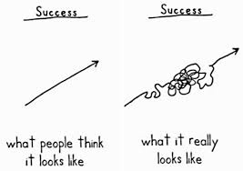

Slide 34
Notes:
deasil - clockwise; in the direction of the sun

Slide 35
Li = one/focus/undivided attention
Notes:
The paradox of knowing yourself. In Zen it is about breathing IN (you) and breathing out (OTHERS). Breath in (you) breath out (others). Breath in (Know yourself), breath out (Forget yourself). Breath in (internal) breathe out (external). The yin and the yang.

Slide 36
Notes:
Headache
Achy sore muscles
Upset stomach
Sore throat and the doctor said: have seat, let me look in your ear.

Slide 37
18
seconds

Slide 38
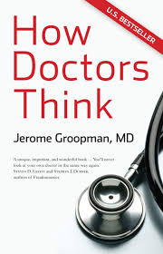

Slide 39
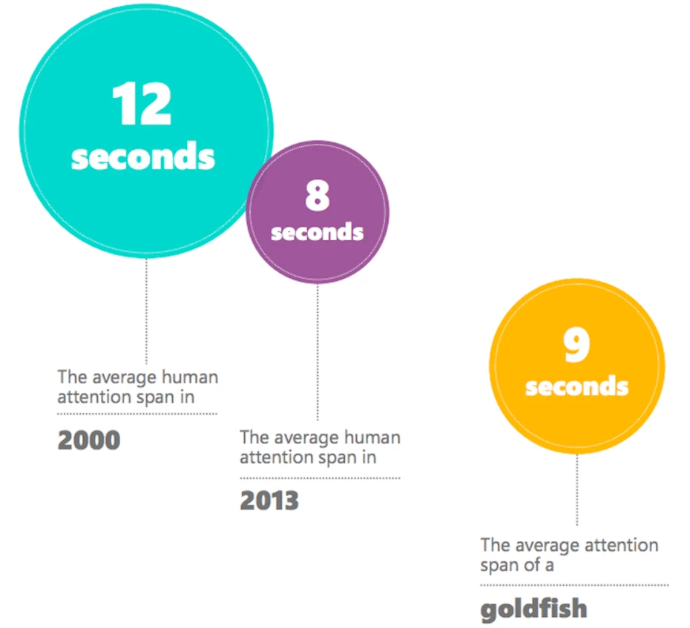

Slide 40
Notes:
deasil - clockwise; in the direction of the sun

Slide 41
Xin = Heart (intention)
Notes:
Pronounced: SIYN
heart, intention, mind, center, core, feeling, emotion

Slide 42
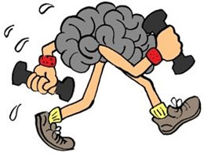
Mammal with biggest heart?

Slide 43
“land” mammal with biggest heart?

Slide 44
LISTEN
WITH THE
EAR
IN YOUR
HEART
Notes:
Listen with the third ear (how the other person feels, how they see the world, how they view things, how they understand it, etc.)

Slide 45
SCHOOL SPELLING BEE

Slide 46
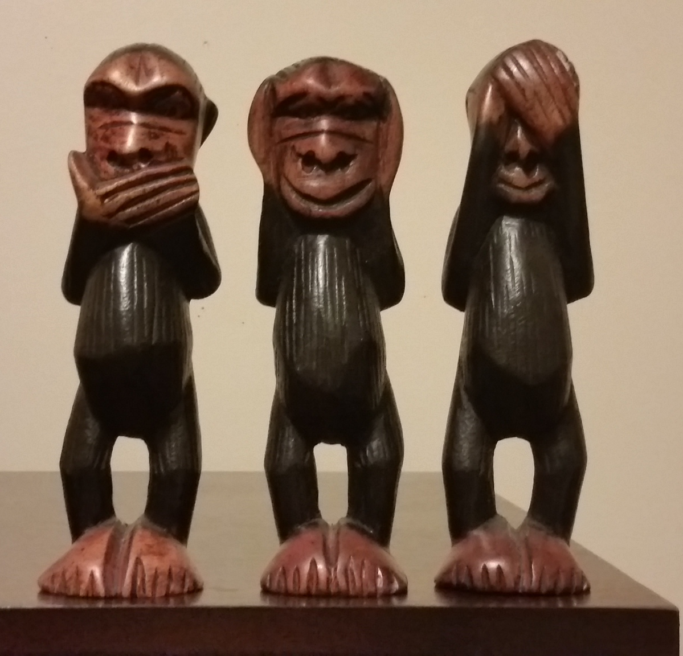
?
“Speak”
no evil
monkey
Hear
no evil
monkey
See
no evil
monkey
Notes:
Myth 1: "Listening is a matter of intelligence."
Myth 2: "Speaking is more important than listening in the communication process."
Myth 3: "Listening is easy and requires little energy."
Myth 4: "Listening and hearing are the same process."
Myth 5: "Listening means only understanding a speaker’s words."
Listening is about intention not perception Reality: Listening is perception not just intent.
Listening is weakness
Listening is passive
Conversation = communication
Apparent listening = Actual Listening [This is related to the notion of listening is intention and perception; it is about being authentic and apparent]
Myth 1: "Listening is a matter of intelligence."
Fact: "Careful listening is a learned behavior." Aristotle: “We are what we repeatedly do. Excellence, therefore, is not an act, but a habit.”
Myth 2: "Speaking is more important than listening in the communication process."
Fact: "Speaking and listening are equally important."
Myth 3: "Listening is easy and requires little energy."
Fact: "Active listeners undergo the same physiological changes as a person jogging."
Myth 4: "Listening and hearing are the same process."
Fact: "Listening is a conscious, selective process while hearing is an involuntary act."
Myth 5: "Listening means only understanding a speaker’s words."
Fact: "Nonverbal signals also help listeners gain understanding."
Myth 5: "Speakers are able to command listening."
Fact: "Speakers cannot make a person really listen."
Myth 6: "Hearing ability determines listening ability."
Fact: "Listening happens mentally—between the ears."
Myth 7: "Speakers are totally responsible for the communication success."
Fact: "Communication is a two-way street."
Myth 9: "Daily practice eliminates the need for listening training."
Fact: "Without effective listening training, most practice merely reinforces negative behaviors."
Myth 10: "Competence in listening develops naturally."
Fact: "Untrained people listen at only 25 percent efficiency."
Years ago she made a video montage for my wife and I’s 15-year anniversary . . .
I thought she would say: “it was the LISTENING MONKEY”—but she had a very unique description, a special “meaning” she attached to this monkey.”

Slide 47
BAD BREATH
MONKEY
Hear no evil
See no evil
Notes:
Myth 1: "Listening is a matter of intelligence."
Myth 2: "Speaking is more important than listening in the communication process."
Myth 3: "Listening is easy and requires little energy."
Myth 4: "Listening and hearing are the same process."
Myth 5: "Listening means only understanding a speaker’s words."
Listening is about intention not perception Reality: Listening is perception not just intent.
Listening is weakness
Listening is passive
Conversation = communication
Apparent listening = Actual Listening [This is related to the notion of listening is intention and perception; it is about being authentic and apparent]
Myth 1: "Listening is a matter of intelligence."
Fact: "Careful listening is a learned behavior." Aristotle: “We are what we repeatedly do. Excellence, therefore, is not an act, but a habit.”
Myth 2: "Speaking is more important than listening in the communication process."
Fact: "Speaking and listening are equally important."
Myth 3: "Listening is easy and requires little energy."
Fact: "Active listeners undergo the same physiological changes as a person jogging."
Myth 4: "Listening and hearing are the same process."
Fact: "Listening is a conscious, selective process while hearing is an involuntary act."
Myth 5: "Listening means only understanding a speaker’s words."
Fact: "Nonverbal signals also help listeners gain understanding."
Myth 5: "Speakers are able to command listening."
Fact: "Speakers cannot make a person really listen."
Myth 6: "Hearing ability determines listening ability."
Fact: "Listening happens mentally—between the ears."
Myth 7: "Speakers are totally responsible for the communication success."
Fact: "Communication is a two-way street."
Myth 9: "Daily practice eliminates the need for listening training."
Fact: "Without effective listening training, most practice merely reinforces negative behaviors."
Myth 10: "Competence in listening develops naturally."
Fact: "Untrained people listen at only 25 percent efficiency."

Slide 48
SCHOOL SPELLING BEE

Slide 49
Notes:
deasil - clockwise; in the direction of the sun

Slide 50
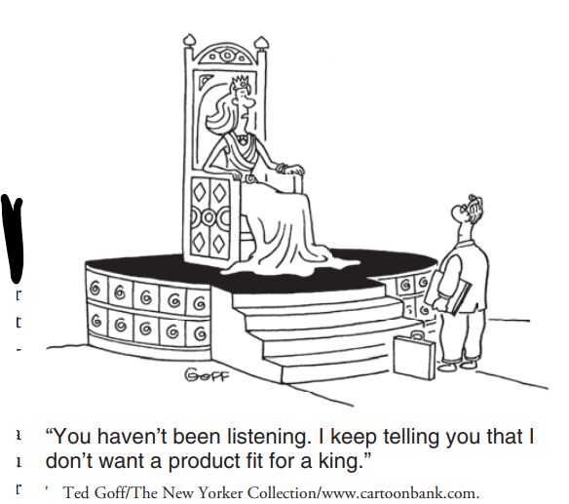

Slide 51
WANG = Royalty

Slide 52
WANG
(royalty)
queen or king
Notes:
"One night, a king and a queen get into a carriage. The king drives, the queen rides behind him. They arrive at a castle, and three people get out of the carriage. How is this possible"
hint, say it out loud
"One night, a king and a queen get into a carriage. The king drives, the queen rides behind him. They arrive at a castle, and three people get out of the carriage. How is this possible"
hint, say it out loud
This doesn’t work with the written word. Us of the Oxford comma would clarify. This speaks to fact that we need all our senses to truly LISTEN. One night, a king and a queen went to bed in their room. No one came in and no one went out. In the morning the king and the queen were tied up. Who tied them up? a queen get into a carriage. The king drives, the queen rides behind him. They arrive at a castle, and three people get out of the carriage. How is this possible"
hint, say it out loud

Slide 53
A form of r-e-s-p-e-c-t is being able to see other’s perspectives
Notes:
Which respective perspective do you expect to respect?

Slide 54
Queen of soul

Slide 55
"To say that a person feels listened to means a lot more than just their ideas get heard. It's a sign of respect. It makes people feel valued."
--Deborah Tannen - Author and Professor of Linguistics Georgetown University
Notes:
This speaks to the power of right relationship with others. That we truly need each other to be fuly human. To be all that we are to be. We really are all caught in a network of mutality. Tied in a single garment of destiny. Gestures – help the talker think; it helps the listener learn (what the speaker means or is seeking to communicate).
Deaf People gesture (on top of the signing)
Blind people gesture
Gestures are universal with all cultures/languages.

Slide 56
Notes:
deasil - clockwise; in the direction of the sun

Slide 57
Er = EAR
Notes:
ear - The vertebrate organ of hearing, responsible for maintaining equilibrium as well as sensing sound and divided in mammals into the external ear, the middle ear, and the inner ear. pronunciation: erh
The Chinese character 耳 (ěr) is a pictograph depicting a human ear. The earliest form of this character was a realistic drawing of an ear, but became more stylized over time.
耳 (ěr) is also a radical, meaning that it is an element of more complex characters. Many of these have something to do with the ear or with hearing.
Here are some characters based on the radical 耳 (ěr):
耽 - dān - indulge;delay
聃 - dān - ears without rim
聆 - líng - apprehend; hear; listen
聊 - liáo - to chat; to kill time
聖 / 圣 - shèng - holy; sacred; saint
聘 - pìn - betrothed; engage (teacher); hire
聚 - jù - gather
聰 / 聪 - cōng - quick at hearing; wise; clever; acute
聽 / 听 - tīng - listen; hear; obey
http://www.ehow.com/video_4403714_write-ear-chinese-symbols.html [Video on how to write the ear]

Slide 58
MAKE IT RAIN EXERCISE
Notes:
There is an O –
Openness
Oneness

Slide 60
GUANACASTE

Slide 61
GUANACASTE = Listening Tree

Slide 62
Notes:
This is the seed I want to put in your mind that it grow into a seed and become a tremendous tree.
Grounding listening in communication, dignity, and concern with another person.
Disposition to listen

Slide 63
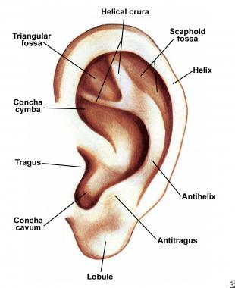
EAR

Slide 64
Notes:
deasil - clockwise; in the direction of the sun

Slide 65
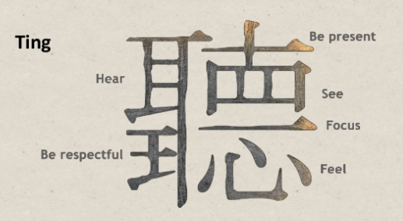

Slide 66
Notes:
The sound made when glass hits glass . . . To listen.
STORY: I’m not like this anymore.
This super-duper complicated and unpronounceable word. And when I finally found the definition at Ohio State University’s language center, this what they told me the word (radicals). The hards word in the world: “TING”

Slide 67
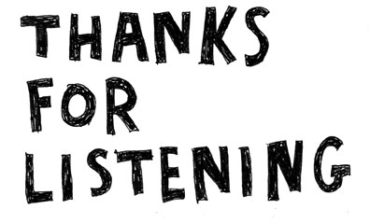
MBU

